Slide 1

Introduction:
Nowadays, fire is the major cause of death in residents due to lack of automation and emergency alert systems. The main source of fire in residents is due to burning of materials, flammable gases, electric circuits, etc.
01
There is no such low cost fire alert systems or automation available at
the homes to provide emergency alerts to the people.
02
03
Fire Alarm Systems are very common in commercial building and factories,
these devices usual contain a cluster of sensors that constantly monitors for
any flame, gas or fire in the building and triggers an alarm if it detects any
of these.

Slide 2

Motivation
01
Fires are one of the most widespread cause of deaths by accident. Instant alert to the fire is necessary to ensure immediate action. Every minute can save many lives in such situations.
02
Detect fire in areas and notify building occupants to take action to escape the dangers of hostile fire.
03
Summon organized assistance to initiate or assist in fire control activities and to initiate automatic fire control and suppression system and to sound alarm.
04
Supervise fire control and suppression systems to assure operational status is maintained to initiate auxiliary functions involving environmental ,utility and process controls.

Slide 3

Objectives
01
To study the working principle of fire alarm and smoke
detecting system.
02
To design, construct fire alarm and smoke detector using digital system.
03
To implement digital
logic design in the
project
04
To discover fires early in their development when time will still be available for the safe evacuation of occupants.

Slide 4
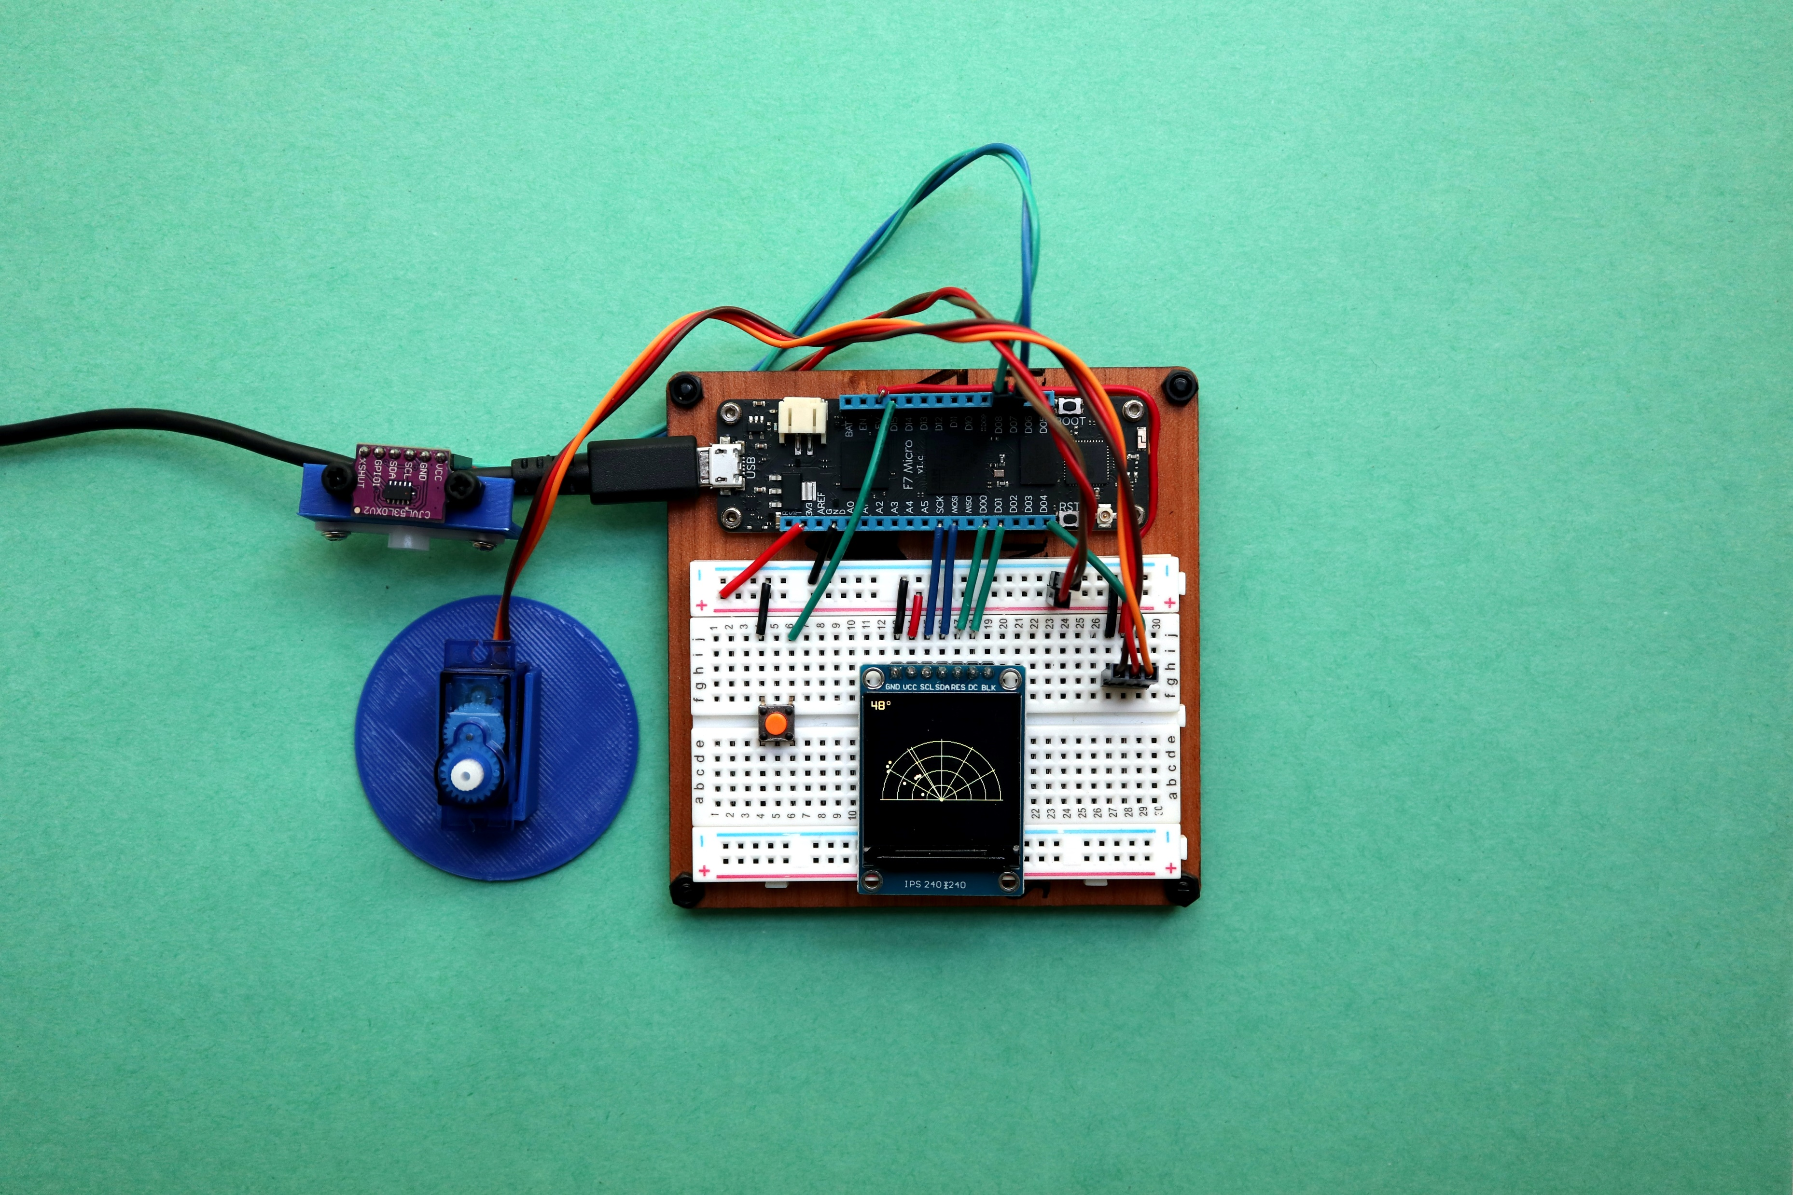

Sensors used:
1.Temperature Sensor:
A temperature sensor is an electronic device that measures the temperature of its environment and converts the input data into electronic data to record, monitor, or signal temperature changes.
2.Gas Sensor:
Gas sensors (also known as gas detectors) are electronic devices that detect and identify different types of gasses. They are commonly used to detect toxic or explosive gasses and measure gas concentration.

Slide 5


THANK
YOU

